Slide 1
Adham Ashraf Saeed
Assignment 2 (SQL)

Slide 2
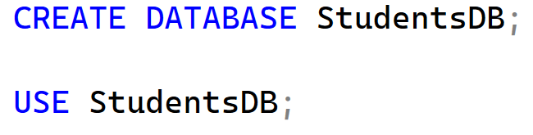
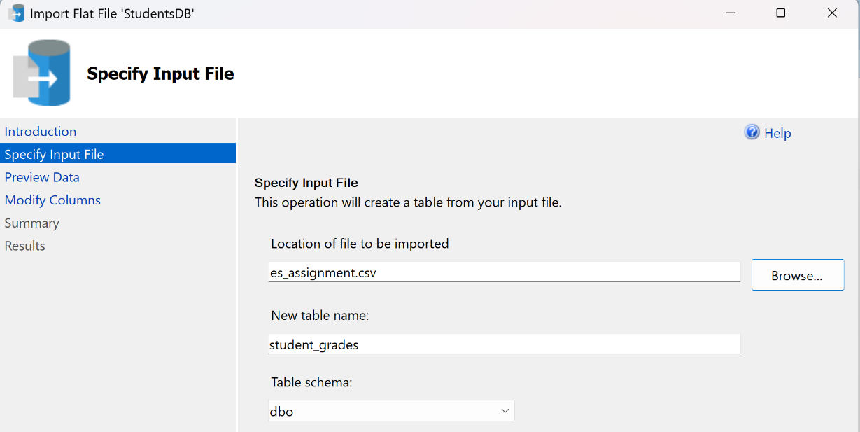
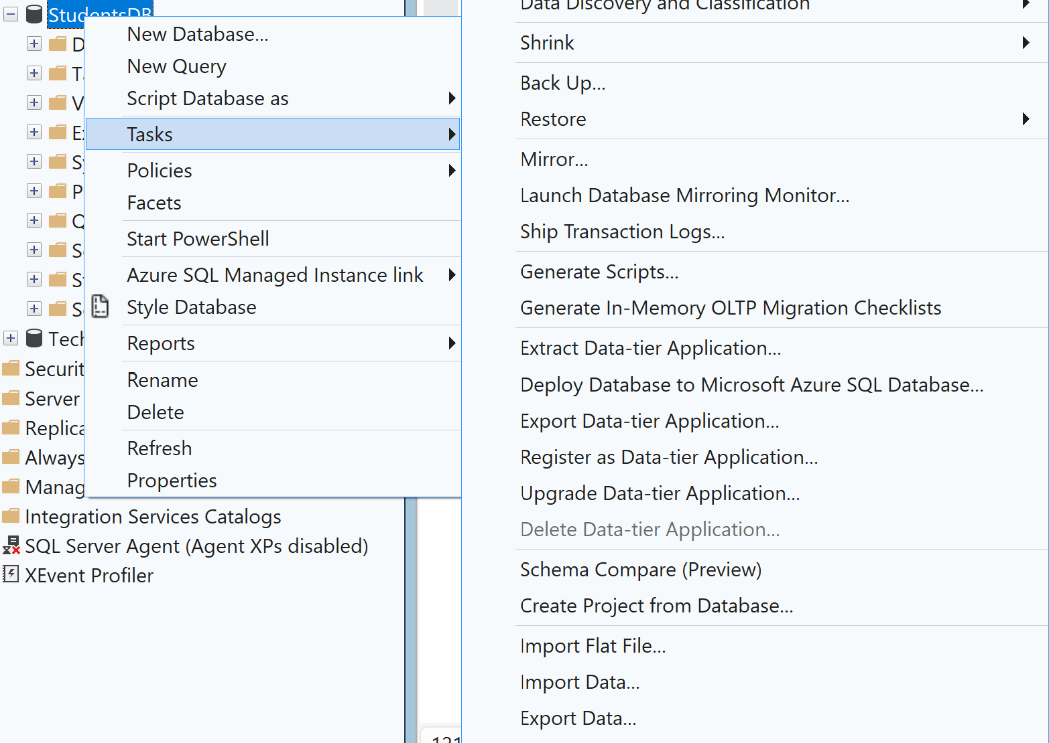
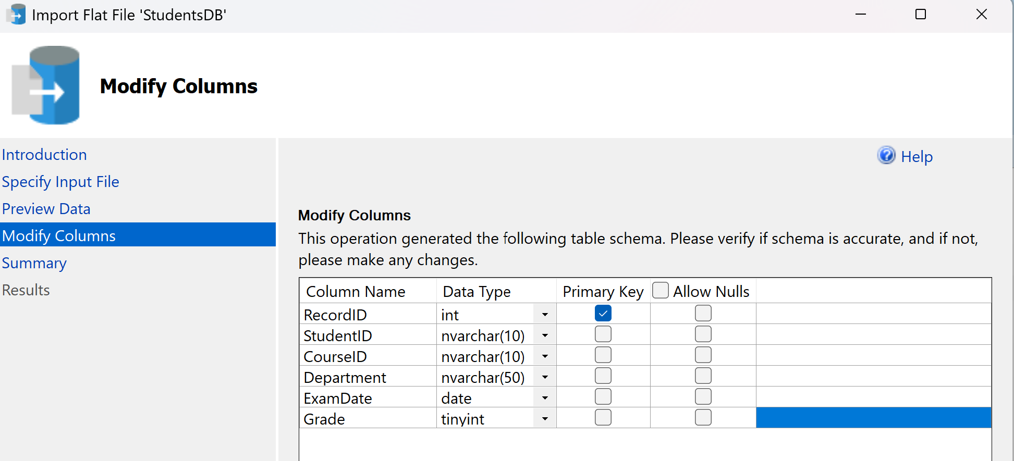
Load the provided dataset into your database

Slide 3




Basic Questions
Query the total number of records.
Query the average grade of all students.
Query the highest grade obtained.
Query the lowest grade obtained.
Query the number of distinct students.

Slide 4
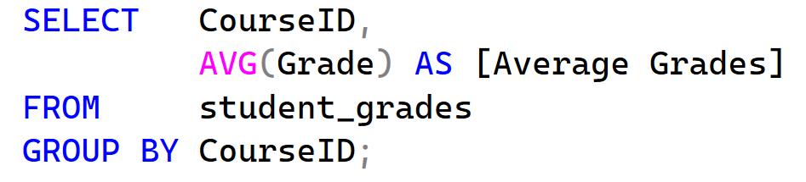
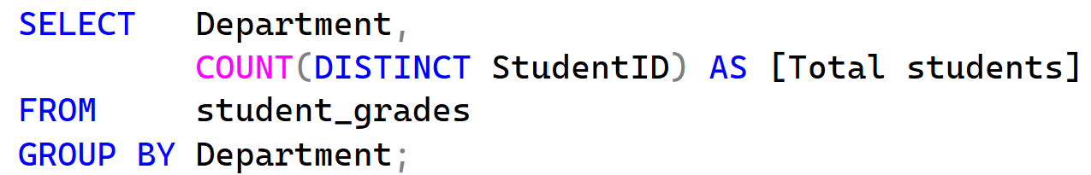
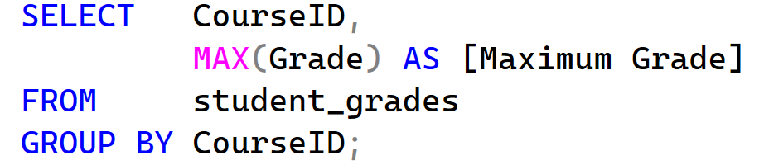
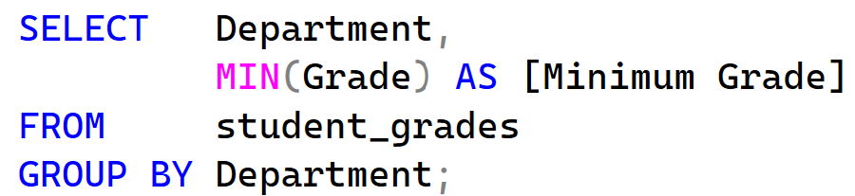
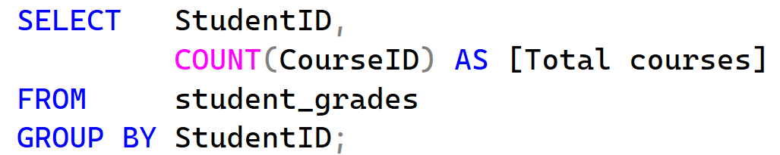
Basic Questions
Query the average grade for each course.
Query the number of students in each department.
Query the maximum grade for each course.
Query the minimum grade for each department.
Query the number of courses taken by each student.

Slide 5
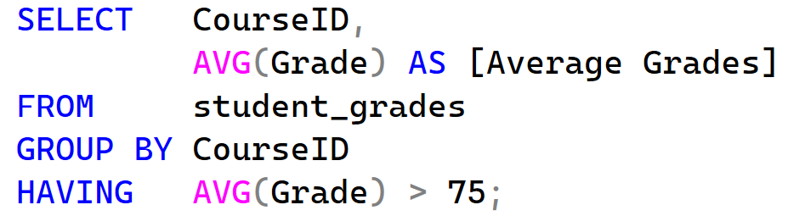
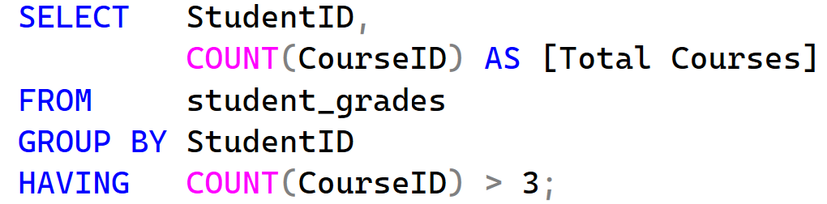
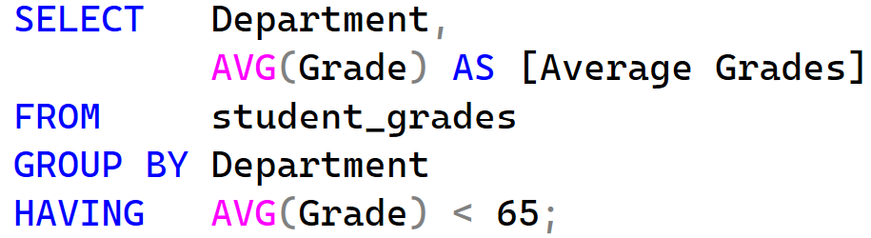
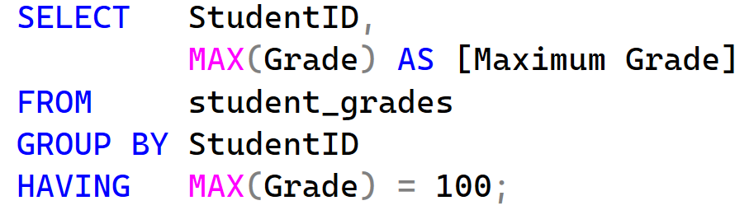
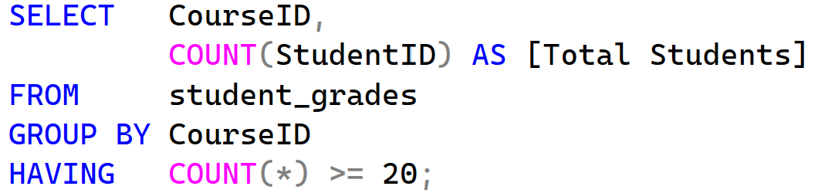
Intermediate Questions
Query courses where the average grade is greater than 75.
Query students who have taken more than 3 courses.
Query departments where the average grade is less than 65.
Query students whose maximum grade is 100.
Query courses that have been taken by at least 20 students.

Slide 6
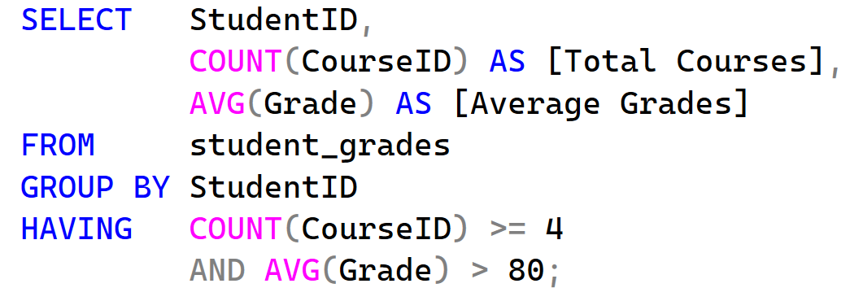
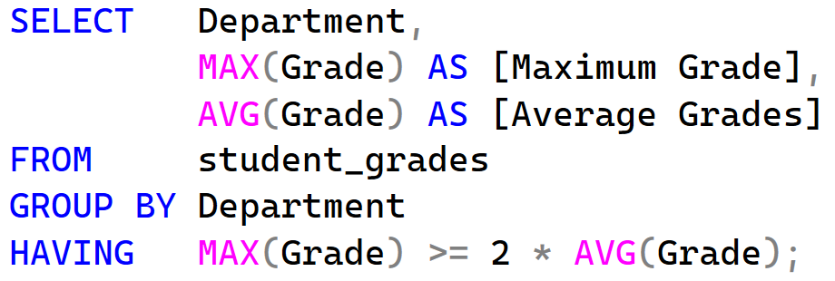
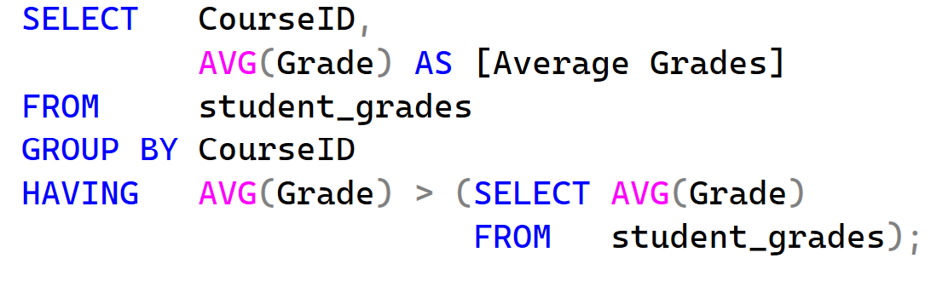
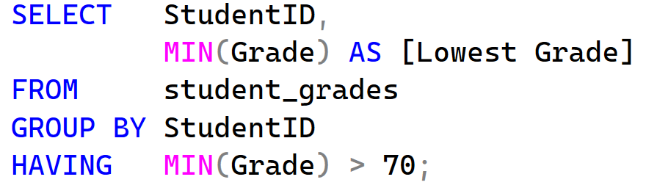
Advanced Questions
Query students who have taken at least 4 courses and whose average grade is greater than 80.
Query departments where the maximum grade is at least twice the average grade.
Query courses whose average grade is higher than the overall average grade.
19 – 20. Query students whose lowest grade is greater than 70.

